Slide 1
What if all the ice melted?
Consider this:
Source: http://ngm.nationalgeographic.com/2013/09/rising-seas/if-ice-melted-map

Slide 2
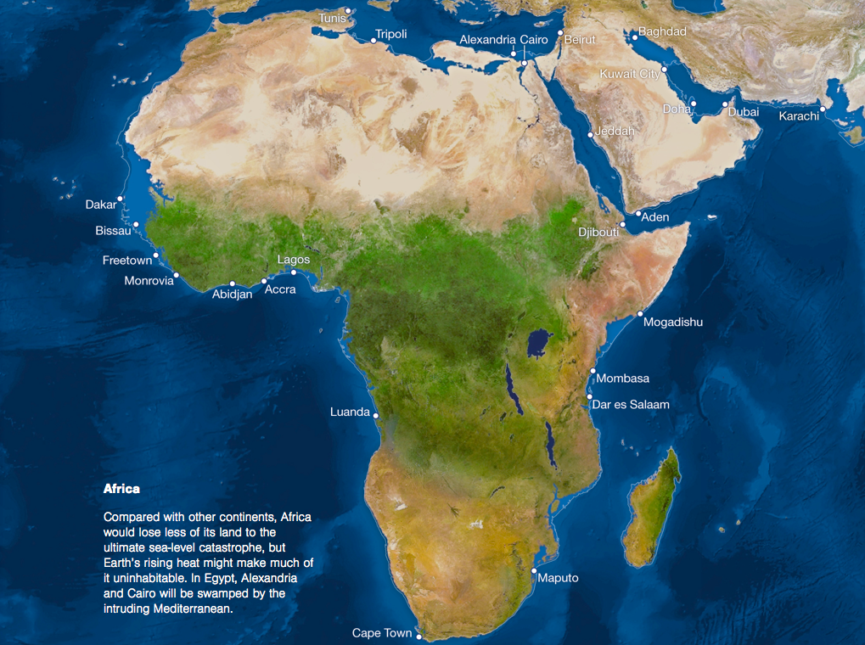

Slide 3
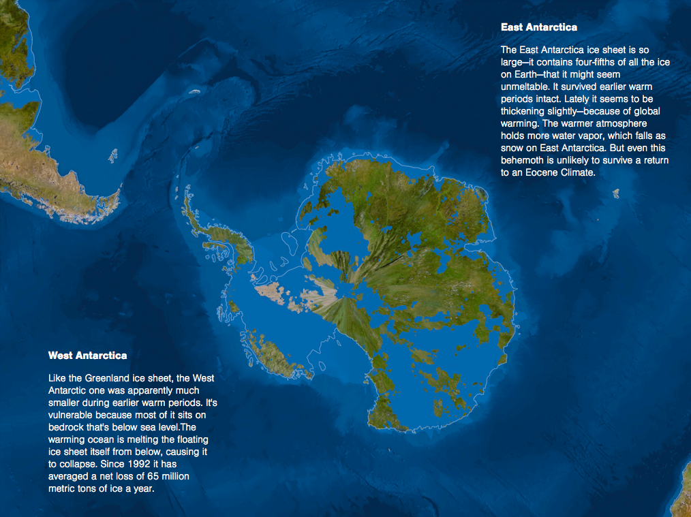

Slide 4
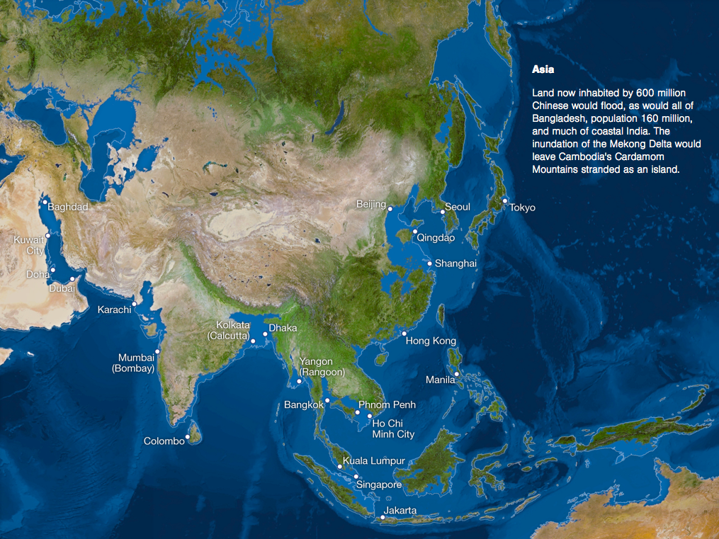

Slide 5
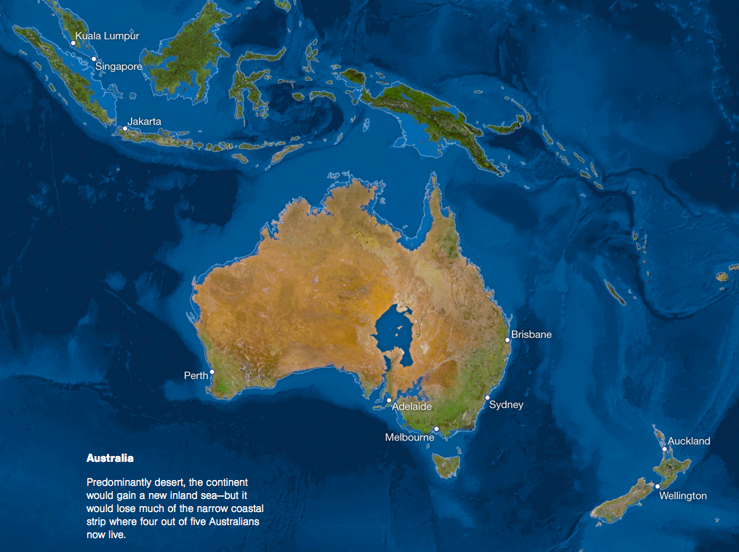

Slide 6
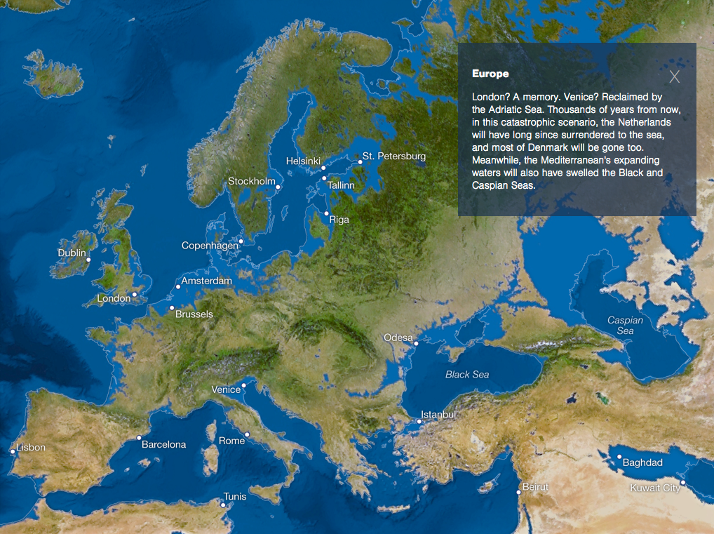

Slide 7
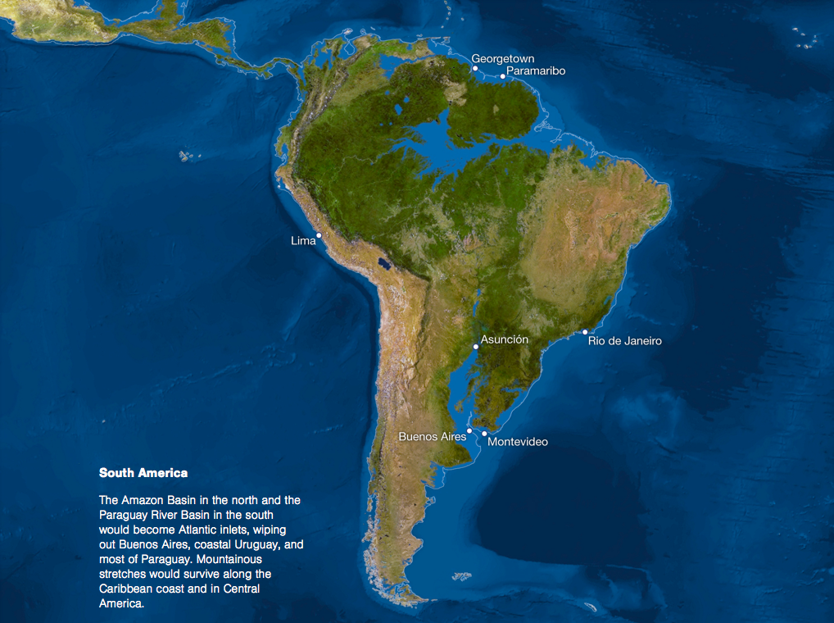

Slide 8
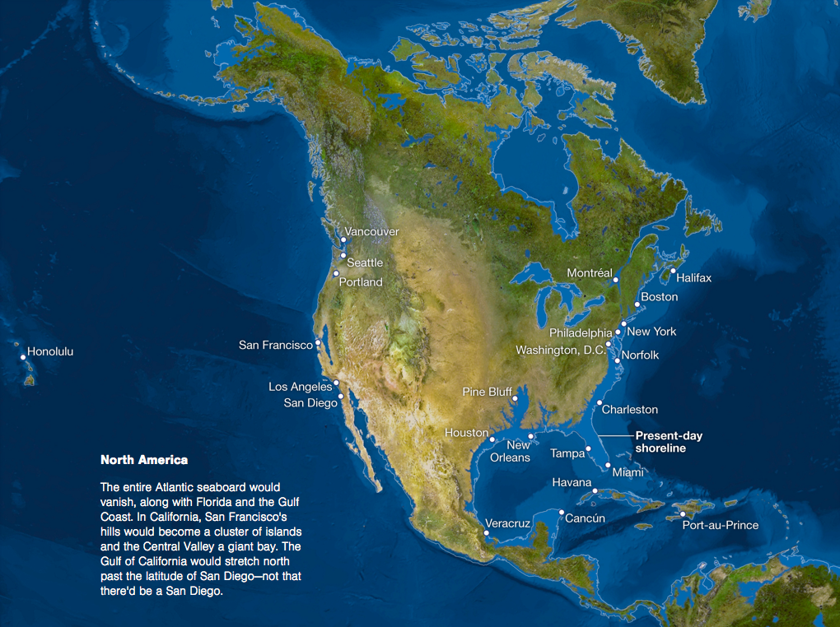

Slide 9
